Slide 1
IIT BOMBAY — DEPARTMENT OF MECHANICAL ENGINEERING
Simulation Based
Toolpath Generation
& Validation for
Robotic Milling
An End-to-End Workflow from CAD/CAM to Physical Robot Execution
Presenters: Aayush Shah, Shashwat Agrawal, Ishaan Mondal, Kartik Goyal
Institution: IIT Bombay
Date: 18/04/2026

Slide 2
Section 1 — Introduction & Objectives
Robotic Milling & The Post-Processor Gap
What is Robotic Milling?
The Post-Processor Gap
Robotic milling uses 6-DOF articulated industrial arms for subtractive machining — milling, drilling, trimming, contouring — replacing conventional CNC tools.
CNC Milling Pipeline
Key Advantages over CNC
Larger reachable workspace
CAD
CAM
Post-Processor
G-code
CNC Controller
Full orientation dexterity
Access to complex undercuts
Freeform geometry capability
Robotic Milling Pipeline
The Fundamental Technical Gap — Post-Processors
CNC Milling (Mature Ecosystem)
Robotic Milling (Fragmented Ecosystem)
CAD
CAM
Post-Processor
Joint + TCP
Robot Controller
G-code is universal fairly universal, post-processors are mature, validated, commercially available for virtually every CAM–machine pairing.
No universal standard — Mitsubishi, FANUC, KUKA, ABB, Yaskawa each use proprietary motion languages and coordinate conventions.
RoboDK: The Bridging Platform
Accepts toolpaths from Fusion 360
Full kinematic simulation & verification
Generates controller-specific programs
The intervention point enabling this workflow

Slide 3
Section 1 — Introduction & Objectives
Research Objectives
1
Toolpath Exploration and Selection
2
TCP Calibration
3
Workflow Validation
4
Failure Identification
5
API-Based Analysis
Characterize and resolve TCP-to-flange calibration for spindle-mounted milling tool, including handle geometry challenges and pose variability
Lay computational groundwork for jerk and stiffness analysis using RoboDK Python API for dynamic performance optimization
Establish validated end-to-end simulation-based workflow from Fusion 360 CAD/CAM to physically executable motion programs on a Mitsubishi robot
Identify, document, and resolve systematic failure modes in code export, file parsing, and controller upload pipeline
Investigate and compare different toolpath strategies in Fusion 360, analyzing their suitability for various geometries and identifying optimal toolpaths for accurate and efficient machining.

Slide 4
Section 2 — Methodology
End-to-End Workflow Architecture
Complete Pipeline — Four Major Stages
Fusion 360
RoboDK
RT Toolbox 3
Physical Robot
CAD + CAM
Simulation + Validation
Controller-Native Sim
Execution
Part geometry, stock, toolpath, post-processor export
TCP setup, kinematic simulation, reachability checks
Parser validation, syntax verification, program execution
Program upload, physical cutting, quality verification
Multi Stage Validation
Why Validation is Necessary
The architectural spine: Two layer verification eliminating risk of discovering errors only at physical execution.
Robot post-processors are fragmented and unreliable, making CAD/CAM outputs inherently untrustworthy.
Layer 1 — RoboDK (Kinematic Level)
Strict Validation Principle
Reachability validation
Singularity detection
Dual simulation embeds validation directly into the workflow through independent kinematic and controller-level checks, ensuring errors are detected before physical execution.
Joint limit compliance
Frame consistency
Layer 2 — RT Toolbox 3 (Controller Level)
1
Fusion 360 → Toolpath correctness
Syntax compatibility
2
RoboDK → Kinematic feasibility
Motion command validation
3
RT Toolbox 3 → Controller compatibility
Program structure verification
4
Physical Robot → Execution validation
Controller-native parser

Slide 5
Section 2 — Methodology
From CAD to Simulation — Fusion 360 to RoboDK
Part A — CAM Toolpath Generation in Fusion 360
Part B — RoboDK Simulation Environment Setup
1. Part Geometry & Stock Definition
Robot Model Import
Part designed or imported; stock geometry explicitly defined for material removal computation and collision detection.
Physical robot model (Mitsubishi RV series) imported from built-in library — accurate kinematic model.
Three Main Coordinate Frames Defined
2. Machining Operations
W
World / Base Frame
Operations constructed in Manufacture workspace:
Root at robot base — all spatial references expressed relative to this
Facing
3D Contouring
Wp
Workpiece Frame
Parallel Passes
Pocket Milling
Part coordinate system positioned relative to base
Multi-Axis Simultaneous
TCP
Tool Frame (TCP)
Functional tool tip relative to flange - most technically demanding
3. Tool Library Entry
Toolpath Import & Validation
Tool library entry matches physical tool geometry, used for selecting the most appropriate tool for the process.
Fusion 360 toolpath imported with correct frame assignment; reachability and singularity checks run across all targets.
Validation Checks
4. RoboDK Integration via Plugin
All targets within joint limits
CAM toolpaths are programmatically imported into RoboDK for simulation, enabling a seamless transition from Fusion 360 to the robot environment.
No singular configurations
Consistent wrist configuration

Slide 6
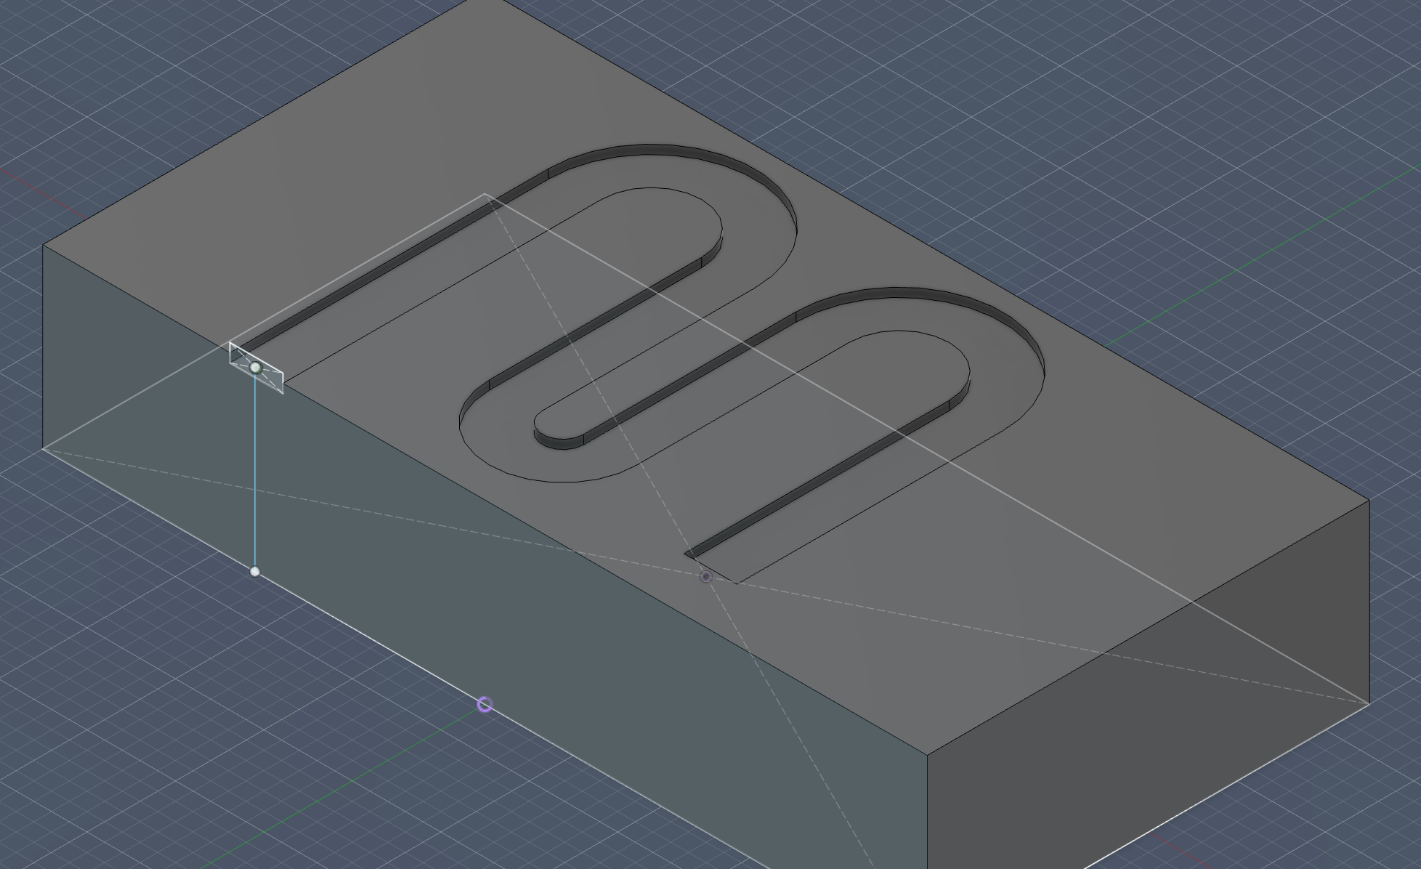
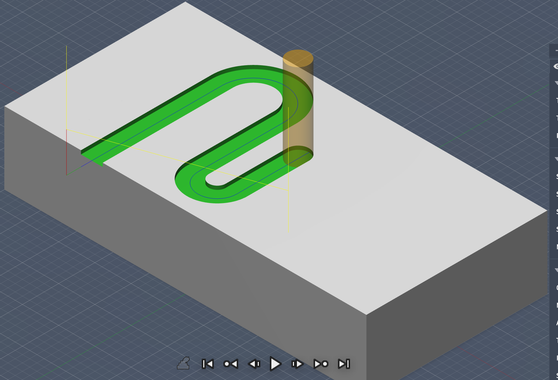

Slide 7
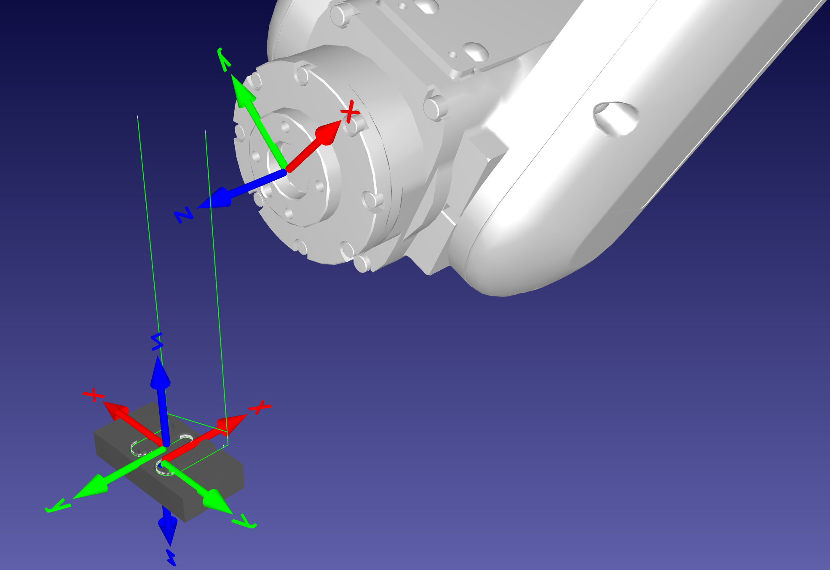
Section 2 — Methodology
TCP Calibration & Reference Frame Finalization
The TCP — Definition and Stakes
Tool Center Point (TCP): precisely defined reference point at functional cutting tip, expressed as position/orientation offset relative to robot flange.
Critical Consequence of TCP Error
Calibration error of even 1mm in any TCP offset component produces same 1mm positional error at every single toolpath target — global systematic offset.
Why Spindle-Mounted TCP took us time.
Milling Spindle (Complex)
Mounted via custom bracket and handle assembly:
Large offset through multiple interfaces
Spindle can shift/tilt depending on tightening
Pose variability between measurement sessions
Single measurement insufficient

Slide 8
Section 3 — Experimental & Modeling Work Done
Experimental Setup & Initial Validation Testing
Physical Laboratory Setup
Experiment 1 — Live Joint Coordinate Verification
Experiment 2 — Manual Target Dry-Run
Robot Hardware
Procedure
Procedure
Mitsubishi RV series 6 DOF robot with milling spindle mounted via custom bracket/handle assembly.
Current joint angular positions (all six joints) streamed live from controller into RoboDK.
Simple manual targets programmed in RoboDK, uploaded to controller, executed in free air (no workpiece contact).
Observation
Purpose
Simulation model mirrored physical robot pose instantaneously — confirming kinematic model correctness.
Validate basic motion program upload pipeline before introducing complex multi target toolpath.
Workpiece Fixture
Positioned on rigid table within reachable workspace — maximizing reachability while maintaining safe clearance.
Significance
Result
Essential sanity check: if simulation and physical robot disagree about configuration, all subsequent simulation results are meaningless.
Robot moved to all manual targets accurately — basic communication, file transfer, and execution pipeline functional.
TCP-IP Communication
Bidirectional link between RoboDK (PC) and Mitsubishi controller for real-time joint streaming and command transmission.
Result
Critical Insight
Live joint readout confirmed model physical synchronization — prerequisite condition satisfied.
This success set an expectation that complex toolpaths upload would be straightforward.

Slide 9
Section 3 — Experimental & Modeling Work Done
Learning Curve: Code Upload Failure & The RT Toolbox 3 Pivot
The Attempt — Complex Toolpath Upload
The Strategic Pivot — RT Toolbox 3
Full multi-target complex toolpath exported from RoboDK in Mitsubishi .PRG format and uploaded to controller using RoboDK itself.
After exhausting direct upload debugging, we tried using Mitsubishi's official offline programming environment.
Result
What RT Toolbox 3 Provides
Controller rejected program outright with parse error — no motion executed, only generic fault code produced. (Unexpected movement of the robot)
Full kinematic simulation (same engine as controller)
Detailed line-referenced error logging
Same parser as physical controller
Complete virtual program validation
Diagnosis Attempts — What Was Tried
Execution
1. Manual .PRG File Examination
.PRG imported and simulated virtually — issues surfaced with actionable specific error messages that pendant failed to provide. (However the direct upload over RoboDK still doesnt work)
Reviewed header structure, motion commands (MOVL, MOVJ, MOVC), label formatting, speed parameters, frame declarations.
Result
Program iteratively corrected until clean simulation — structurally necessary intermediate validation gate.
2. Controller Pendant Diagnostics
Accessed error logs — returned generic fault codes with insufficient information to pinpoint specific cause.
3. Systematic Candidate Iteration
Updated Pipeline Architecture
Tested motion type, speed format, frame conflicts, program name restrictions, header formatting — root cause not identified.
RoboDK
RT Toolbox 3
Controller

Slide 10
Section 3 — Experimental & Modeling Work Done
Finalized End-to-End Workflow
Primary methodological contribution: Definitive validated workflow — every step grounded in lessons from preceding experimental iterations.
1
Fusion 360
2
RoboDK Setup
3
Live Sync
4
TCP Application
Part geometry, stock, strategy, toolpath, tool library, post-processor export
Robot import, world/workpiece/tool frame definition, toolpath import
Joint positions via TCP-IP, simulation synchronized to real-world
Calibrated values as Tool Frame, transformation chain verified
5
Workpiece Reg.
6
Toolpath Alignment
7
RoboDK Validation
8
.PRG Export
Robot jogged to touch workpiece at reference point, pose recorded
TCP aligned with targets, joint angles extracted, reachability verified
Complete toolpath simulated, kinematic errors identified and corrected
Motion program exported in Mitsubishi .PRG format
9
RT Toolbox 3
10
Physical Exec.
Validation Status
Native simulation, no syntax/motion errors confirmed
Dual-validated .PRG uploaded and executed on physical robot
Kinematically verified
Controller-validated
Physically executed

Slide 11
Section 4 — Key Findings
Key Findings
1
Dual-Simulation Validation is Structural Necessity
2
TCP Calibration is a High Risk Single Step
Direct RoboDK to controller pipeline unreliable without controller-native intermediate simulation.
TCP error is uniquely dangerous — globally propagating, single error affects every target identically, impossible to detect from machining error pattern alone.
Non-Redundant Error Detection
Spindle Handle Variability
Spindle handle-induced pose variability is practically significant, systematically underestimated source of TCP uncertainty — must be managed through repeated measurement.
RoboDK Catches:
RT Toolbox 3 Catches:
• Reachability failures
• Syntax incompatibilities
• Singularities
• Command mismatches
Future Recommendation
• Joint limit violations
• Structure failures
Formal TCP auto-calibration routine — robot touches fixed precision reference sphere from multiple orientations, controller solves TCP analytically.
• Frame misassignments
• Parser errors
3
Multi-Axis Toolpath Simulation Successfully Validated
Multi-axis milling toolpaths for complex freeform geometries successfully generated in Fusion 360 and validated in RoboDK — smooth, continuous, singularity-free motion.
Validation Evidence
Correct TCP orientation maintained throughout
Robot arm continuously reorienting for tool-surface normal alignment
No kinematic violations detected
Capability Confirmed
RoboDK is production capable for multi-axis robotic milling program generation; workflow generalizable to new geometries.

Slide 12
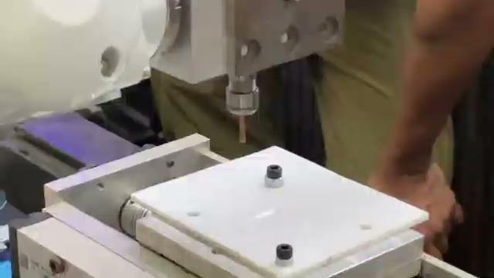
Section 4 — Key Findings
Key Findings

Slide 13
Section 5 — Remaining Work
Remaining Work I — Literature Landscape & Research Gaps
Topic Cluster 1 — Robotic Milling Accuracy
Topic Cluster 2 — TCP Calibration Methods
Systematic Comparison
Methodology Survey
Positional and orientational accuracy: robotic milling vs. conventional CNC machining.
• Manual gauging (used in this work)
• 4-point and multi-point touch-off routines
Error Source Characterization
• Vision guided calibration approaches
Documented sources of dimensional error:
• Joint compliance and backlash
Quantitative Comparison
Achievable TCP calibration accuracy across methods — assessing whether manual approach is within acceptable band.
• Thermal drift
• TCP calibration error
Spindle-Mounted Tool Focus
• Base-frame registration error
Specific focus on spindle-mounted tools where handle geometry and mount variability create documented challenges.
Topic Cluster 3 — Simulation-Based Validation
Framework Review
Existing tools and how they handle RoboDK to controller gap:
Dual-Simulation Survey
Are there published workflows using dual-simulation (CAM-side + controller-native) similar to RoboDK + RT Toolbox 3?
Post-Processor Evaluation
How do researchers validate robotic post-processor correctness without exhaustive physical testing?

